Slide 1
Final Project Presentation
Video Game Sales Insights

Slide 2

Setting the Scene
Understanding Game Sales Across Regions Content
Current Assumption
GameCo’s current understanding is that video game sales are fairly consistent across different regions.
Challenge
I’m here to challenge that assumption. The data shows some clear regional differences in what genres and platforms are most popular, which can help GameCo be more strategic.
What you’ll see today
Key insights that show how preferences vary between North America, Europe, and Japan—and what that means for GameCo’s marketing and sales strategies.

Slide 3
Table of contents
01
02
03
04
05
Exploring Genre
Key Insights
Genre Sales by region
Genre Analysis on Regional Market
Revision
Recommendation
Conclusion
Updated Understanding of Regional Preferences
Recommended Actions for GameCo
Summary & Next Steps

Slide 4
01
Exploring Genre Preferences
by Region
Genre Sales by Region Visualization

Slide 5
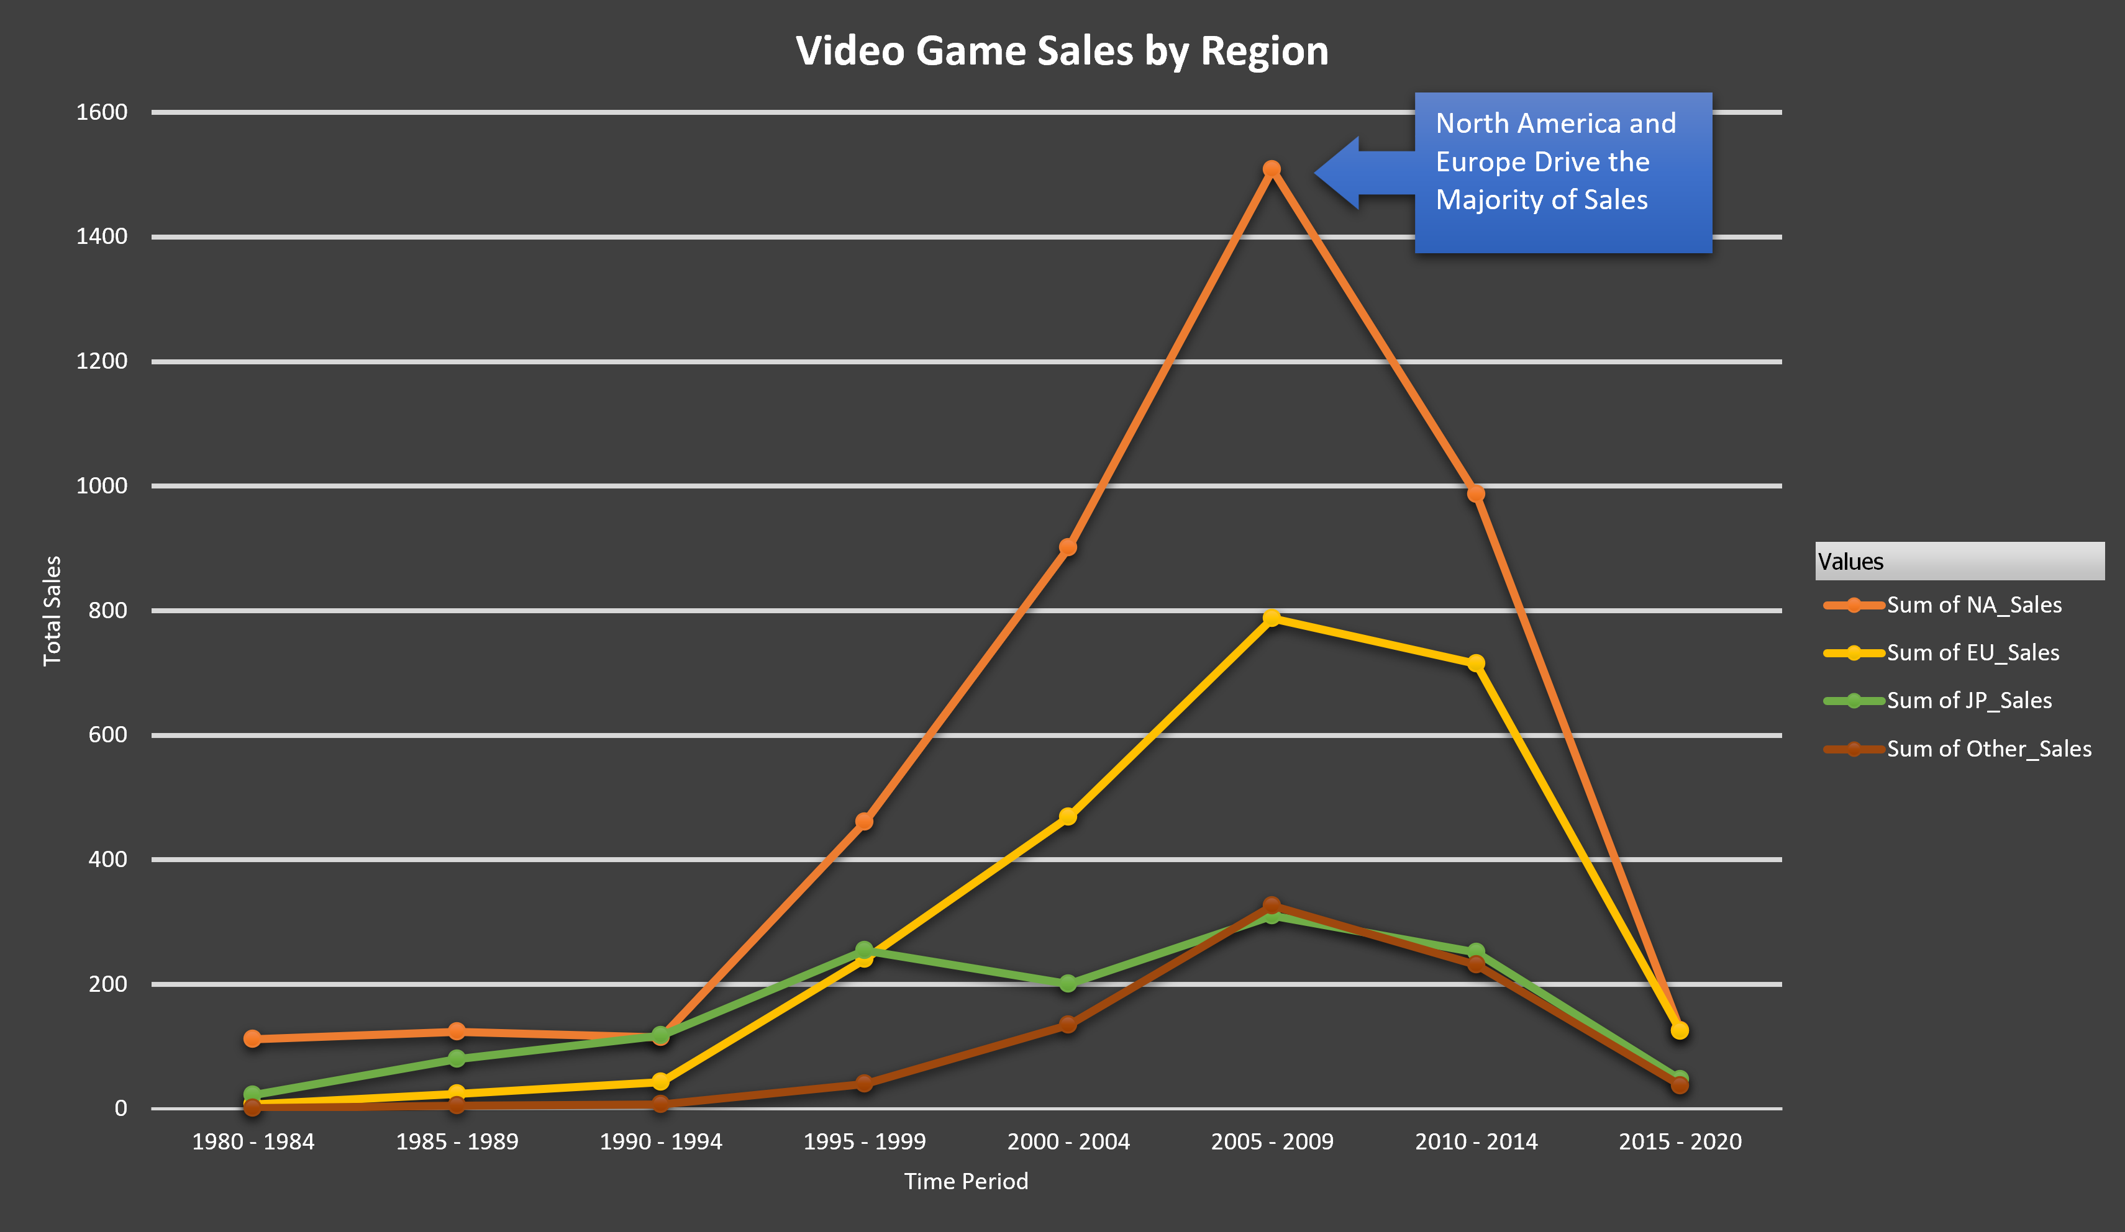
The peak in sales between 2005-2009 was led by North America and Europe, showing their dominant role in the global gaming market. A sharp decline in sales is observed after 2010 across all regions.

Slide 6
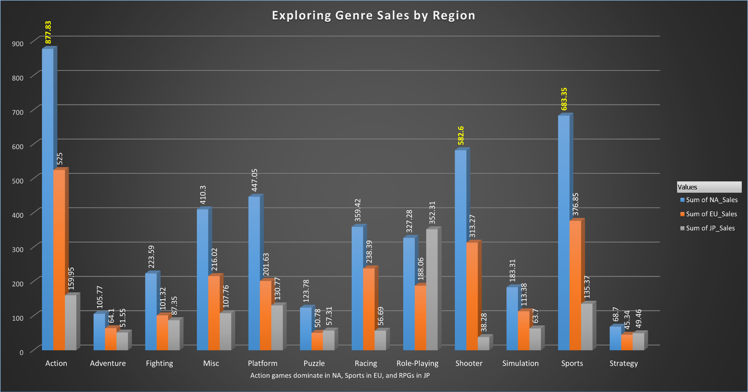
This chart shows the popular genres for each region: Action games take the lead in
North America, Sports dominate in Europe, and RPGs are at the top in Japan.

Slide 7
02
Key Insights from Genre Analysis
Regional Market Insights

Slide 8
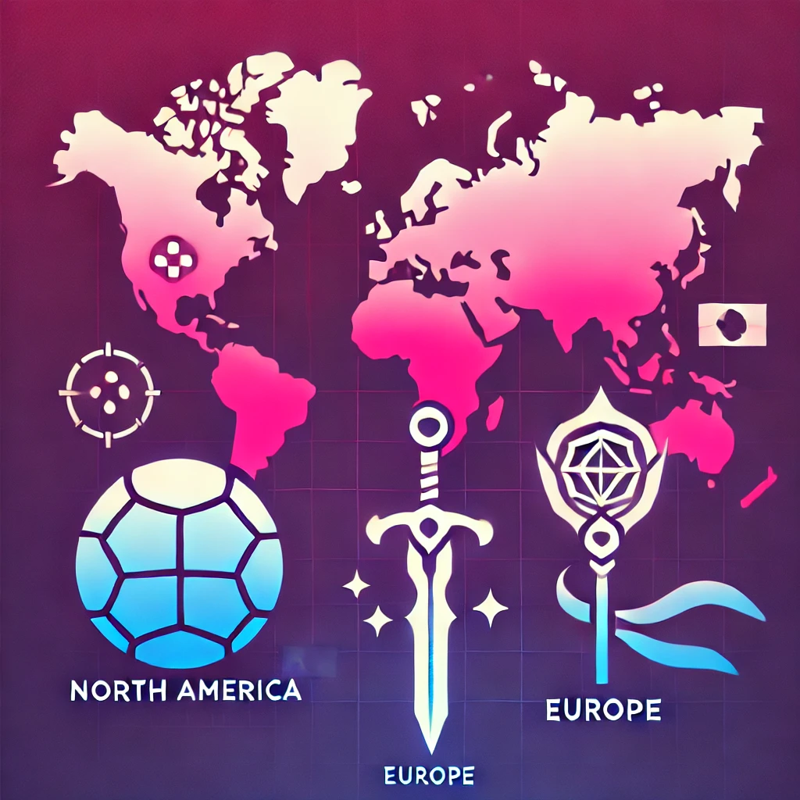

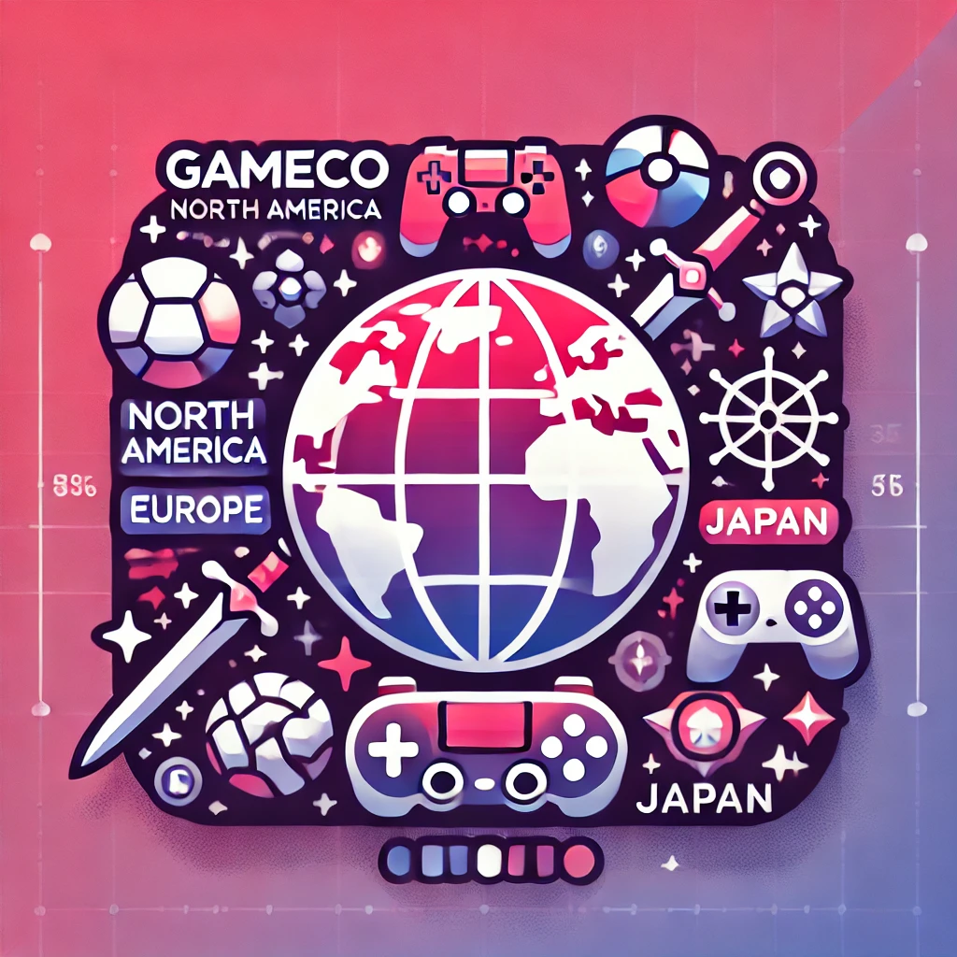
We noticed clear regional preferences for game genres: North America loves Action, Europe is all about Sports, and Japan prefers RPGs.
This insight highlights that GameCo cannot adopt a 'one-size-fits-all' strategy for these regions if it wishes to maximize market reach
GameCo needs a region-specific focus to maximize impact, rather than treating all regions with a single approach.
By understanding these preferences, GameCo can better align its marketing strategy to maximize regional impact.

Slide 9
03
Revised Understanding
Updated Understanding of Regional Preferences

Slide 10

From the analysis, we’ve gained a new perspective: Each region has its unique game preferences that require a focused marketing strategy.
North America loves Action games
Europe prefers Sports titles
Japan is all in for RPGs.
Moving forward, GameCo should adapt the marketing budget to align with these distinct regional tastes.

Slide 11
04
Recommended Actions from GameCo
Strategic Recommendations

Slide 12
Tailor Marketing Campaigns
Optimized Inventory
Focus marketing on Action games in North America, Sports games in Europe, and RPGs in Japan.
Adjust inventory according to regional demand and platform popularity.
New Publisher Partnerships
Watch for Trends
Collaborate with publishers to deliver genre-specific content tailored to each region.
Monitor emerging platforms or genre popularity shifts across different regions.

Slide 13
05
Conclusion
Summary & Next Steps

Slide 14

To maximize success, GameCo needs to recognize the unique preferences in each region.
Tailored marketing campaigns and publisher partnerships will help align GameCo’s strategy with regional interests.
Optimizing inventory and staying ahead of trends will ensure that GameCo remains competitive and prepared for future shifts.
Let's align our strategies to better serve each market and drive growth for 2017 and beyond.

Slide 15
Thank You
Questions & Discussion

Slide 16
Thank you for your time. I’m happy to discuss any questions or further thoughts you have about the strategy going forward.
—Yarisel Velacanto

